Slide 1

FDIC Institutional Analysis Report
An In Depth analysis on FDIC Institutions, Span of Control and Efficiency
By Gloria Shao, Ashley Samuda, Xin Li, Cici Chen

Slide 2
Agenda
Institution Introduction
Current Challenge and Demand Identification
Data Modeling and Database Preparation
Location Positioning and Business Value Analysis
Limitation and Improvement
Summary

Slide 3
Federal Deposit Insurance Corporation (FDIC)
The Federal Deposit Insurance Corporation (FDIC) is a governmental institution whose main mission is to maintain stability and consistency in the nation’s financial systems and retains confidence of the general public in the US Financial system and its participating financial institutions.
The FDIC directly supervises and examines more than 5000 banks and savings associations for operational compliance, safety and soundness.

Slide 4
Demand Identification
Simplify and normalize data for a more efficient management purposes.
Utilize data to analyze how geographical institution allocation can affect institutional resource allocation.
Identify potential customer opportunity based on economic and institutional location analysis
Notes:
Need to simplify
Simplify and normalize data into a more user friendly , scalable database that allows for the data about new institutions to be added, examined and supervised easily as well as to update or delete any necessary data as needed.
We want to effectively use the data to analyze the institutional population by state, city and county to see how that will affect our own staffing and other institutional resource allocation by location.
Lastly, to use this data gathered to show which locations are dense vs less dense to provide institutions with information which areas have opportunities for more customer convenience to ensure that more US citizens, residents and any one eligible for an account to have easy access to insured saving options in such a volatile economic landscape.

Slide 5
Data Preparation
5,000 Institutions FDIC directly supervised
Data Collected from over 27,624 institutions
Data Cleaning and Normalization:
Unrelated data
Redundancy
Reformat Data
Data with less business value to our core analysis purposes
Notes:
Need to simplify

Slide 6
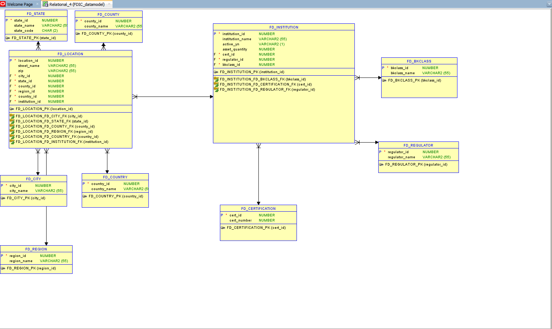
Data Modeling and Database Analysis

Slide 7
Regional Analysis

Slide 8
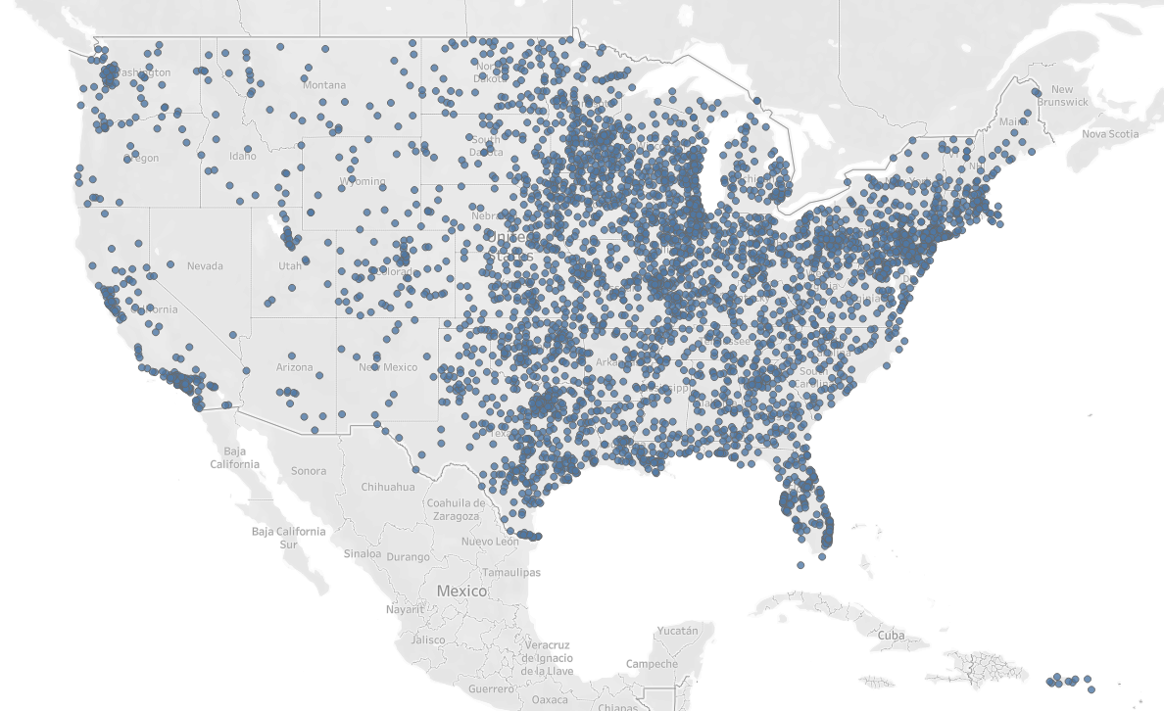
FDIC Institutions Location Distribution

Slide 9
Location Affects Institution Distribution
East coast has more institutions given its political, business, and economics environment
Most institutions are distributed along coast

Slide 10
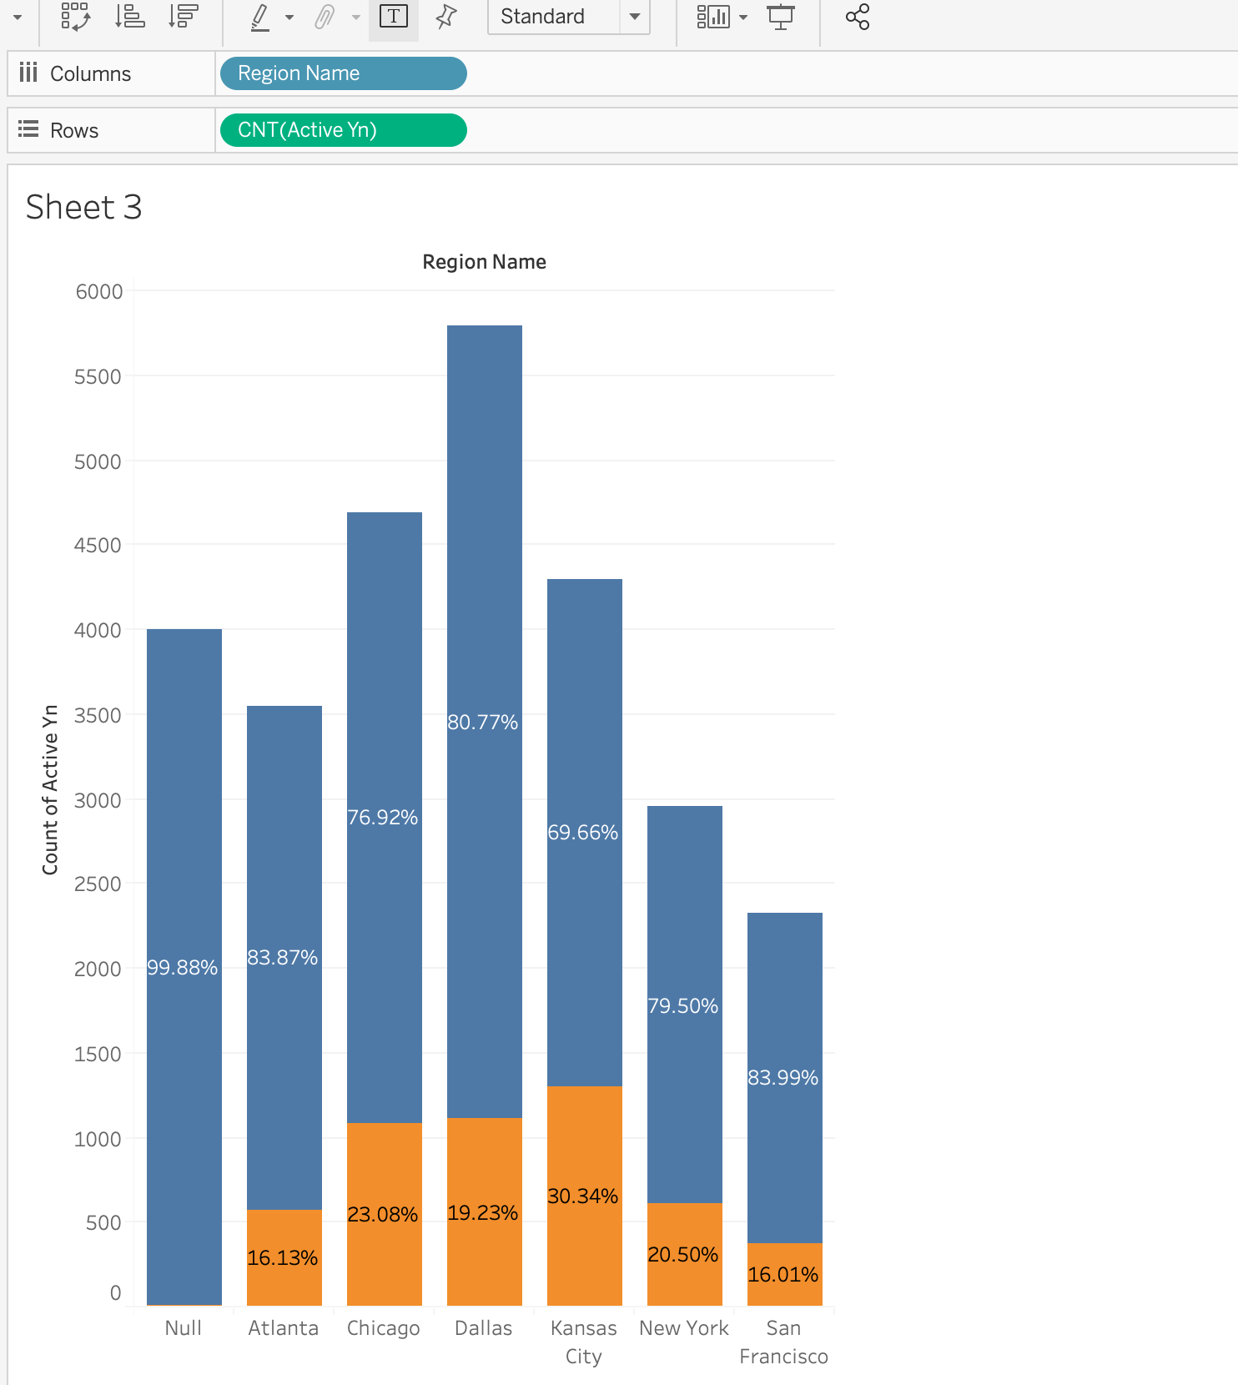
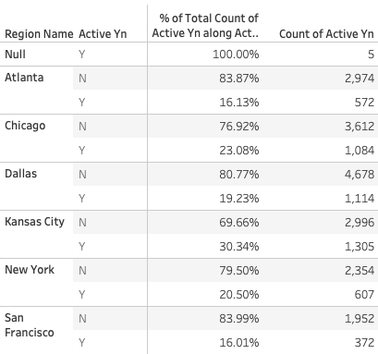
Location Business Value Analysis
Notes:
create view active_regn_view
as
select *
from (
select distinct region_name, active_yn, count(active_yn) over (partition by region_name order by active_yn ) as active_regn
from (
select regn.region_name, inst.active_yn
from fd_region regn
inner join fd_location loc
on regn.region_id = loc.region_id
inner join fd_institution inst
on loc.institution_id=inst.institution_id
))
select * from active_regn_view

Slide 11
Location Business Value Analysis
Notes:
Insights:
Kansas city has the least active institution pct
SF has the most active institution pct.
create view active_regn_view
as
select *
from (
select distinct region_name, active_yn, count(active_yn) over (partition by region_name order by active_yn ) as active_regn
from (
select regn.region_name, inst.active_yn
from fd_region regn
inner join fd_location loc
on regn.region_id = loc.region_id
inner join fd_institution inst
on loc.institution_id=inst.institution_id
))
select * from active_regn_view

Slide 12
Location and Business Value Analysis
Chicago,76.92%
New York,79.50%
SF,83.99%
Kansas,69.66%
Atlanta,83.87%
Dallas,80.77%
Metropolitan cities have relatively higher active institution percentage.
Notes:
Insights:
Kansas city has the least active institution pct
SF has the most active institution pct.
create view active_regn_view
as
select *
from (
select distinct region_name, active_yn, count(active_yn) over (partition by region_name order by active_yn ) as active_regn
from (
select regn.region_name, inst.active_yn
from fd_region regn
inner join fd_location loc
on regn.region_id = loc.region_id
inner join fd_institution inst
on loc.institution_id=inst.institution_id
))
select * from active_regn_view

Slide 13
Institutional

Slide 14
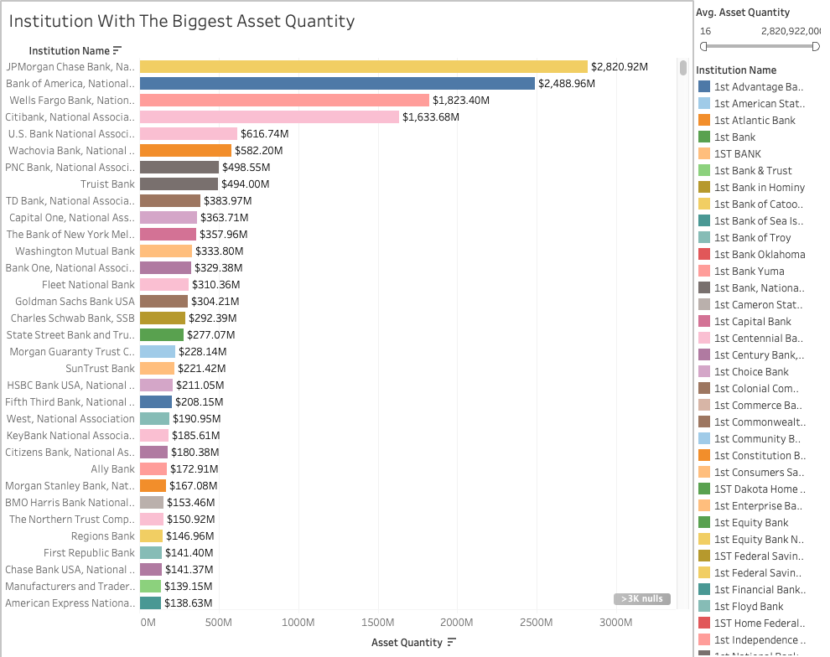
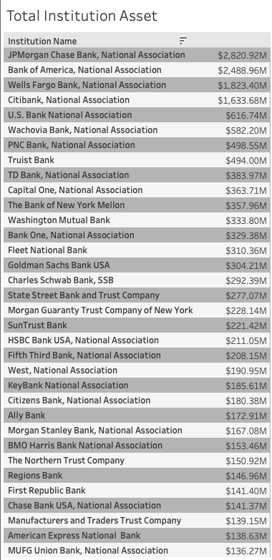
Institution and Asset Relations

Slide 15
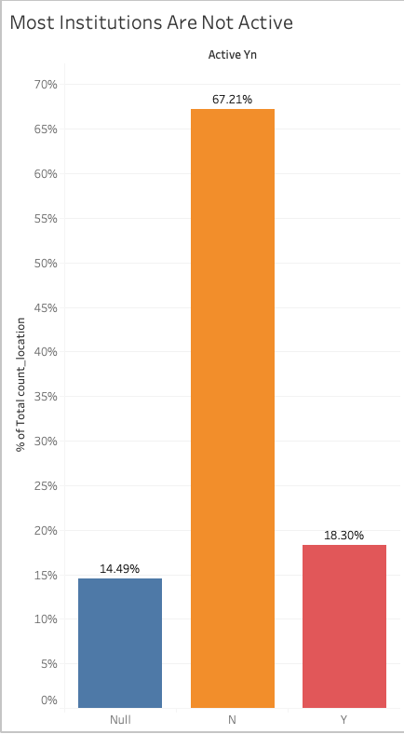
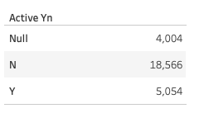
More Inactive Institutions Than Active Institutions
Notes:
create view active_pct_view
as
select *
from (
select distinct active_yn, categorized_quantity/ttl_id as active_pct
from (
select count(institution_id) over(partition by active_yn) as categorized_quantity , count(institution_id) over () as ttl_id, active_yn
from fd_institution
)
)
select * from active_pct_view

Slide 16
Institutional Classifications
Bank Charter Class:
N = commercial bank, national (federal) charter and Fed member, supervised by the Office of the Comptroller of the Currency (OCC)
SM = commercial bank, state charter and Fed member, supervised by the Federal Reserve (FRB)
NM = commercial bank, state charter and Fed nonmember, supervised by the FDIC
SB = savings banks, state charter, supervised by the FDIC
SA = savings associations, state or federal charter, supervised by the Office of Thrift Supervision (OTS)
OI = insured U.S. branch of a foreign chartered institution (IBA)

Slide 17
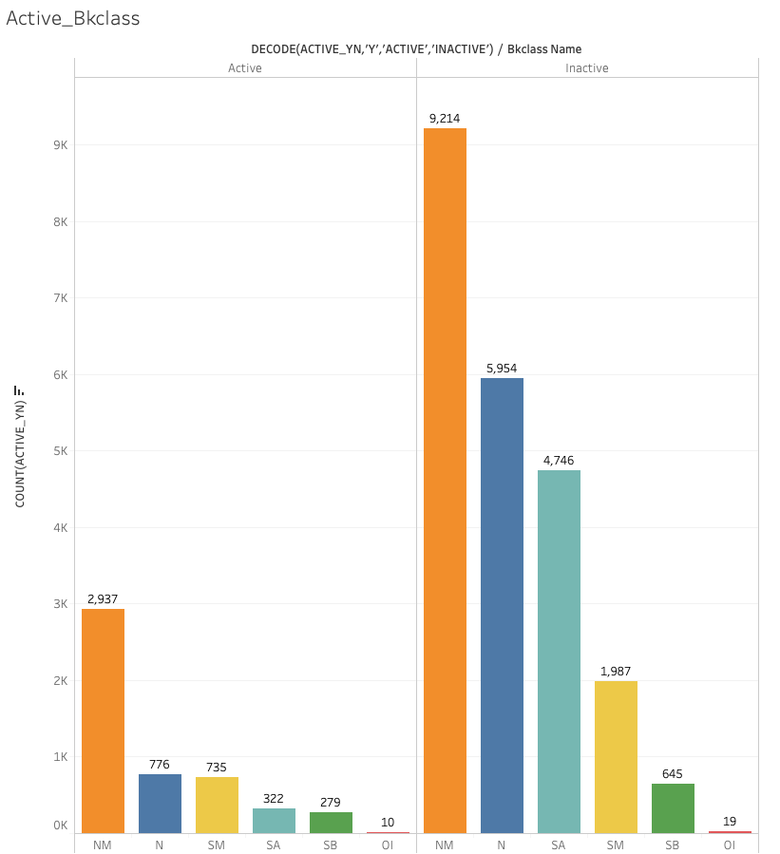
Quantity Doesn’t Equal to Efficiency
Vertically, ‘NM’ has the most amount of both active and inactive institutions.
Notes:
create or replace view bkclass_active_view
as
select *
from (
select distinct bkclass_name,
decode (active_yn,'Y','Active','Inactive'),
count(active_yn)
from (
select bk.bkclass_name, inst.active_yn
from fd_bkclass bk
inner join fd_institution inst
on bk.bkclass_id=inst.bkclass_id)
group by bkclass_name,decode (active_yn,'Y','Active','Inactive')
)
select * from bkclass_active_view

Slide 18
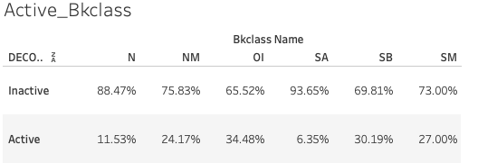
Quantity Doesn’t Equal to Efficiency
Horizontally, ‘OI’ has the most percentile of active institutions.
Notes:
create or replace view bkclass_active_view
as
select *
from (
select distinct bkclass_name,
decode (active_yn,'Y','Active','Inactive'),
count(active_yn)
from (
select bk.bkclass_name, inst.active_yn
from fd_bkclass bk
inner join fd_institution inst
on bk.bkclass_id=inst.bkclass_id)
group by bkclass_name,decode (active_yn,'Y','Active','Inactive')
)
select * from bkclass_active_view

Slide 19
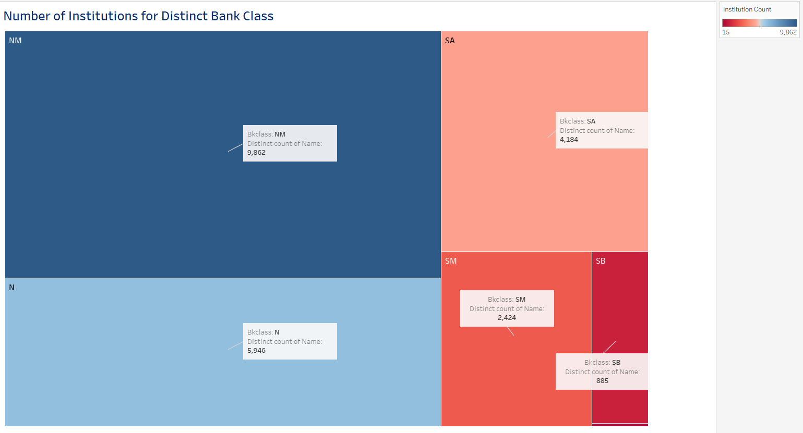
Institutional Bank Classification

Slide 20
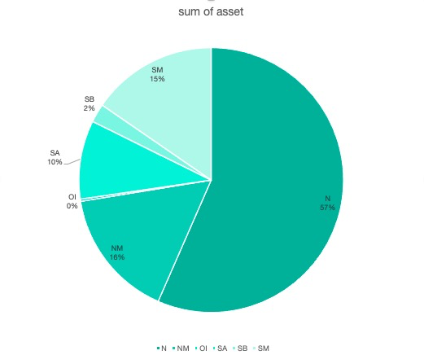
Sum of asset percentage within different Bank Classifications
N class bank has the most asset
OI class bank has the least asset
Notes:
create view pct_sum_view
as
select *
from (
select distinct bkclass_name, pct_sum/ttl as pct_sum
from (
select distinct bkclass_name,
sum_of_asset/count(bkclass_name) over (partition by bkclass_name) pct_sum, sum(sum_of_asset) over ( ) ttl
from (
select distinct bkclass_name, sum(asset_quantity) over (partition by bkclass_name) as sum_of_asset
from (
select bk.bkclass_name, insti.asset_quantity
from fd_bkclass bk
inner join fd_institution insti
on bk.bkclass_id=insti.bkclass_id
where asset_quantity is not null
))
)
order by pct_sum desc)
select * from pct_sum_view

Slide 21
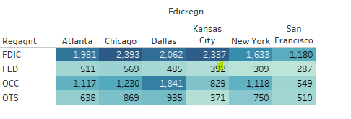
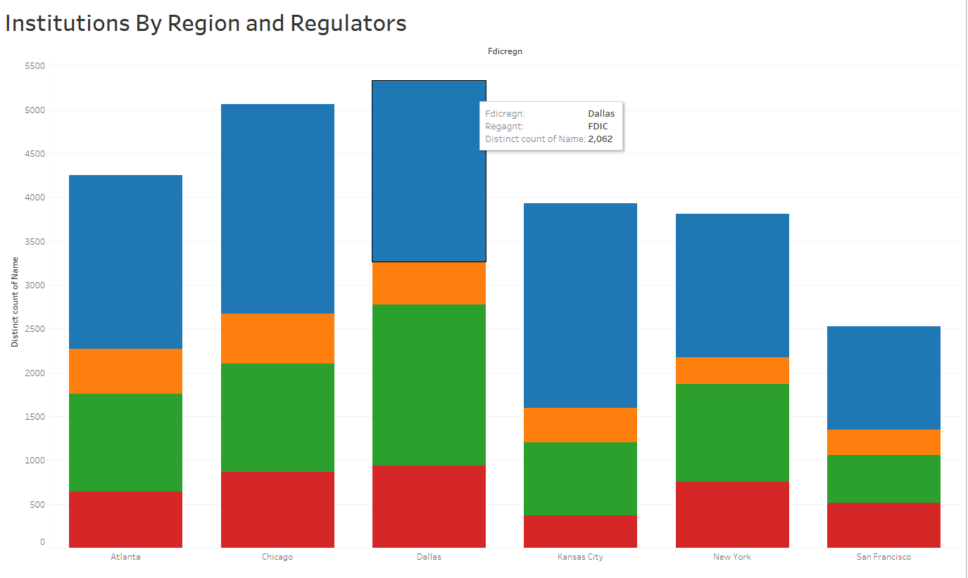
Institutions by Region and Regulators
Notes:
create view region_regulator_view
as
select *
from (
select distinct regulator_name, region_name, count(institution_id)
from (
select reg.regulator_name,inst.institution_id,region.region_name
from fd_regulator reg
inner join fd_institution inst
on reg.regulator_id = inst.regulator_id
inner join fd_location loc
on loc.institution_id = inst.institution_id
inner join fd_region region
on region.region_id = loc.region_id)
group by regulator_name, region_name)
select * from region_regulator_view

Slide 22
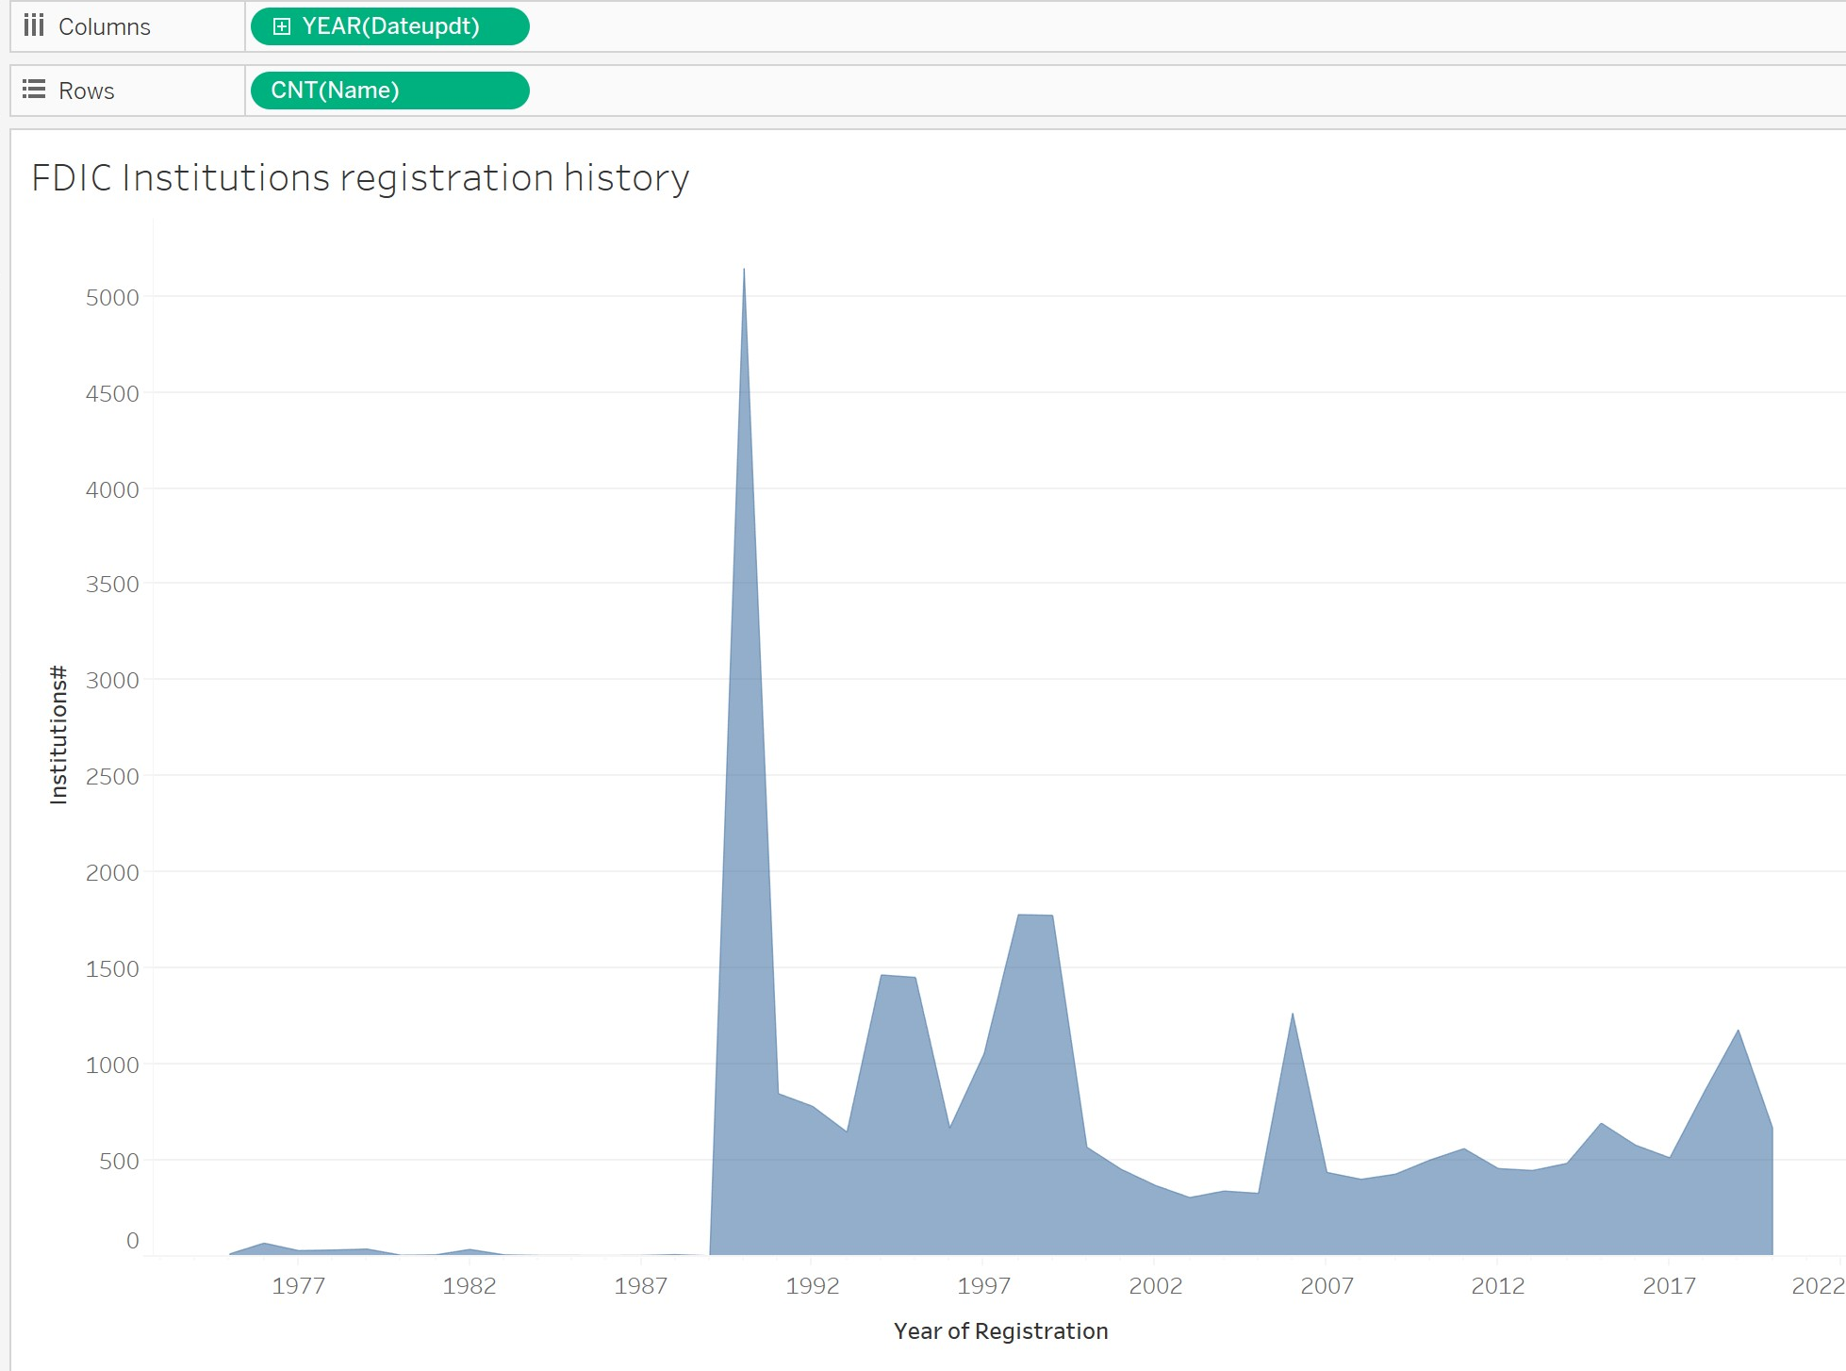
FDIC Institutions Registration History
Notes:
select * from sc_fd_regulator_view
create or replace view sc_fd_regulator_view
as
select regulator_name as REGULATOR, count(institution_id) as regulated_institutions
from fd_institution
join fd_regulator using (regulator_id)
where active_yn = 'Y'
group by regulator_name
order by count(institution_id) desc

Slide 23
FDIC Institutions Registration History
In the 1920s and early 1930s, a rise in bank failures created a national crisis, wiping out many Americans’ savings. In 1933, the FDIC was first established by Congress to maintain stability and public confidence in the nation's financial system.
•Insure deposits;
•Examine and supervise financial institutions for consumer protection;
•Make large and complex financial institutions resolvable;
•Manage receiverships.
Notes:
select * from sc_fd_regulator_view
create or replace view sc_fd_regulator_view
as
select regulator_name as REGULATOR, count(institution_id) as regulated_institutions
from fd_institution
join fd_regulator using (regulator_id)
where active_yn = 'Y'
group by regulator_name
order by count(institution_id) desc

Slide 24
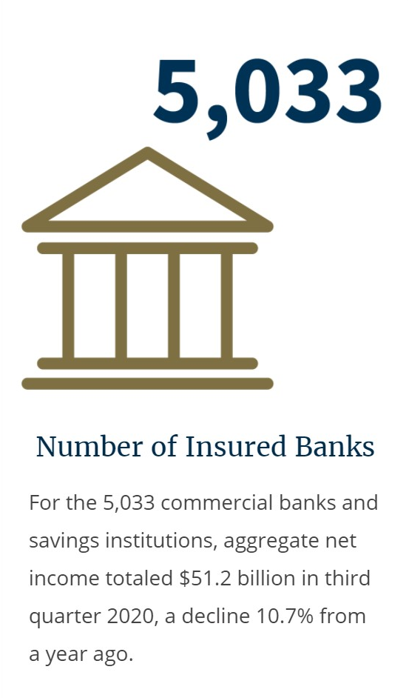
FDIC Institutions Registration History
The 1990s
The economy displays less volatility in growth, unemployment, and inflation than in previous decades.
The Saving & Loan crisis that began in the early 1980s ends in the mid-1990s as numerous banks and financial institutions registered with FDIC
Federal Deposit Insurance Corporation Improvement Act (FDICIA) of 1991
The 2000s
By 2004, three banks exceed a trillion dollars in assets. The number of banks declines. The number of branches increases. Interest rates are low.
The FDIC consolidates into six regional offices.
2020: 5033 insured banks
Source: https://www.fdic.gov/

Slide 25
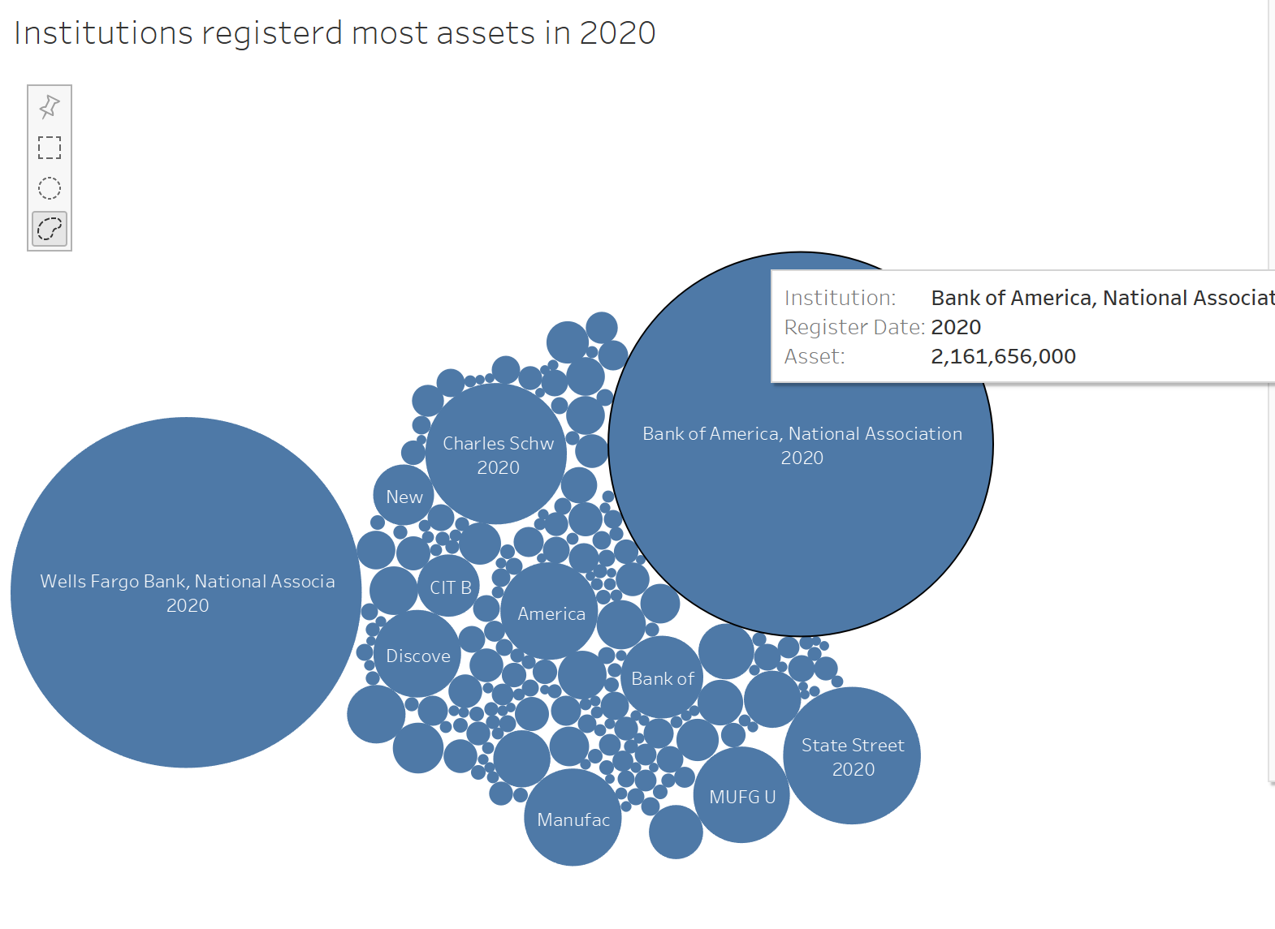
Top Asset Registration by Institution (Year 2020)
Top 30% banks/financial institutions with most assets registered with FDIC
Considered as large & safe banks.
However, only 40% of total deposits in the U.S are insured by FDIC
Notes:
WITH top_asset AS (
SELECT
name as institution,
TO_CHAR(dateupdt, 'YYYY') as register_date,
asset,
ROUND(CUME_DIST() OVER (
PARTITION BY TO_CHAR(dateupdt, 'YYYY')
ORDER BY asset DESC
),2) cume_dist
FROM
sc_fd_stage
WHERE
TO_CHAR(dateupdt, 'YYYY') = 2000
SELECT * FROM
top_asset
WHERE
cume_dist <= 0.30
and asset is not null;

Slide 26
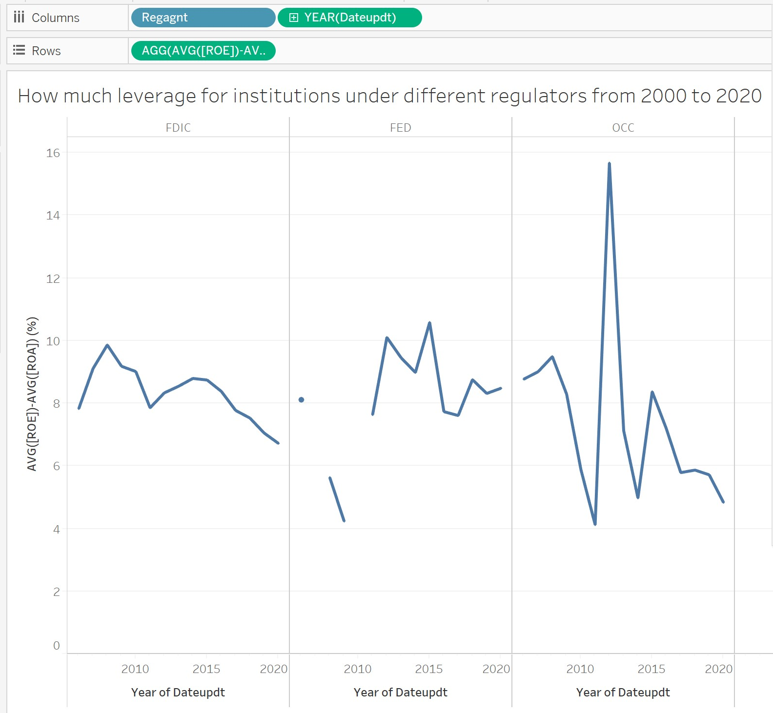
Institutional Leverage by Regulators (2000 - 2020)
The bank leverage ratio (or Tier 1) evaluates how leveraged a bank is in relation to its overall assets. It’s used by regulators to ensure the capital adequacy of banks
The higher the leverage, the higher the likelihood that the bank could withstand a negative shock to its balance sheet.
Thus with enough deposits to protect depositors and promote the stability

Slide 27
Regulational Span of Control

Slide 28
Regulating Agents
Included in Database : 4 Distinct Federal regulators of banks and savings and loan institutions (Now 3 Before July 21, 2011, there were four federal regulators):
Federal Deposit Insurance Corporation (FDIC) - responsible for state-chartered banks (not members of the Federal Reserve System and state chartered savings banks. )
Federal Reserve Board (FRB) - Primary Federal regulator responsible for state-chartered commercial bank (members of the Federal Reserve System).
Office of the Comptroller of the Currency (OCC) - responsible for nationally chartered commercial banks and federally chartered savings and loan associations.
[Before 7/21/11] Office of Thrift Supervision (OTS) - was responsible for federally chartered savings and loan associations, federal savings banks and state-chartered savings and loan associations.

Slide 29
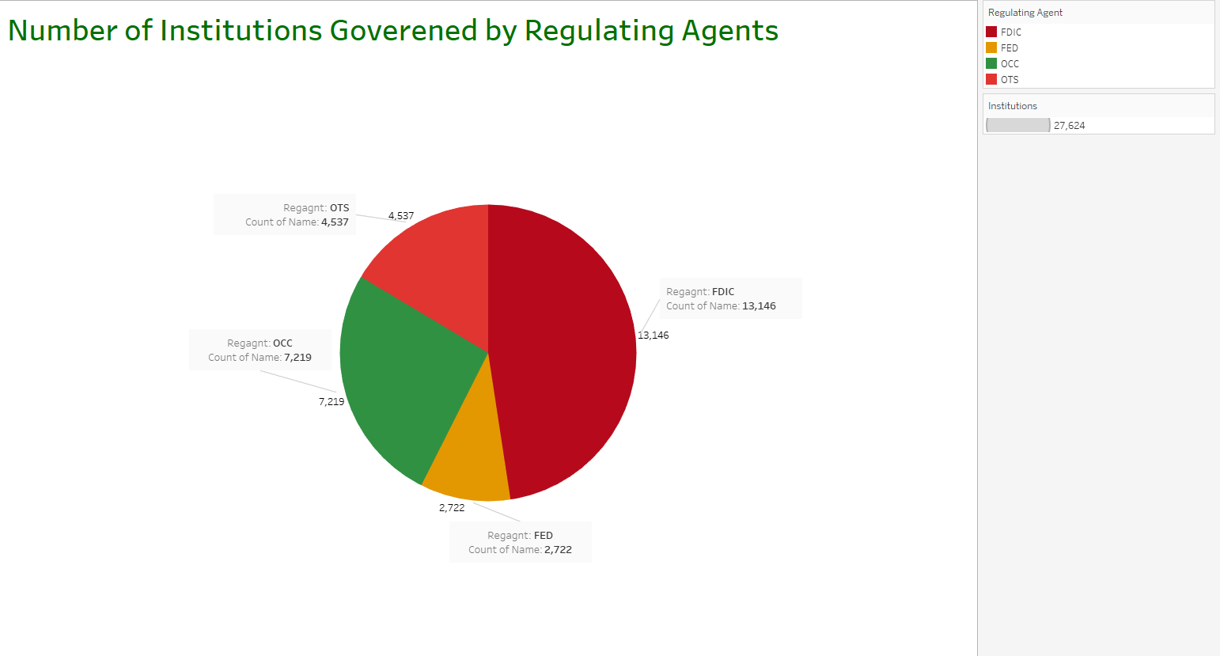
Institutions Governed By FDIC and Other Agents
The FDIC Regulates almost half of the institutions within the United States compared to other Regulating Agents
Notes:
create view count_institution_byregulator_view
as
select *
from (
select count(institution_id), regulator_name
from (
select reg.regulator_name,reg.regulator_id,inst.institution_id
from fd_regulator reg inner join fd_institution inst
on reg.regulator_id=inst.regulator_id)
group by regulator_name)

Slide 30
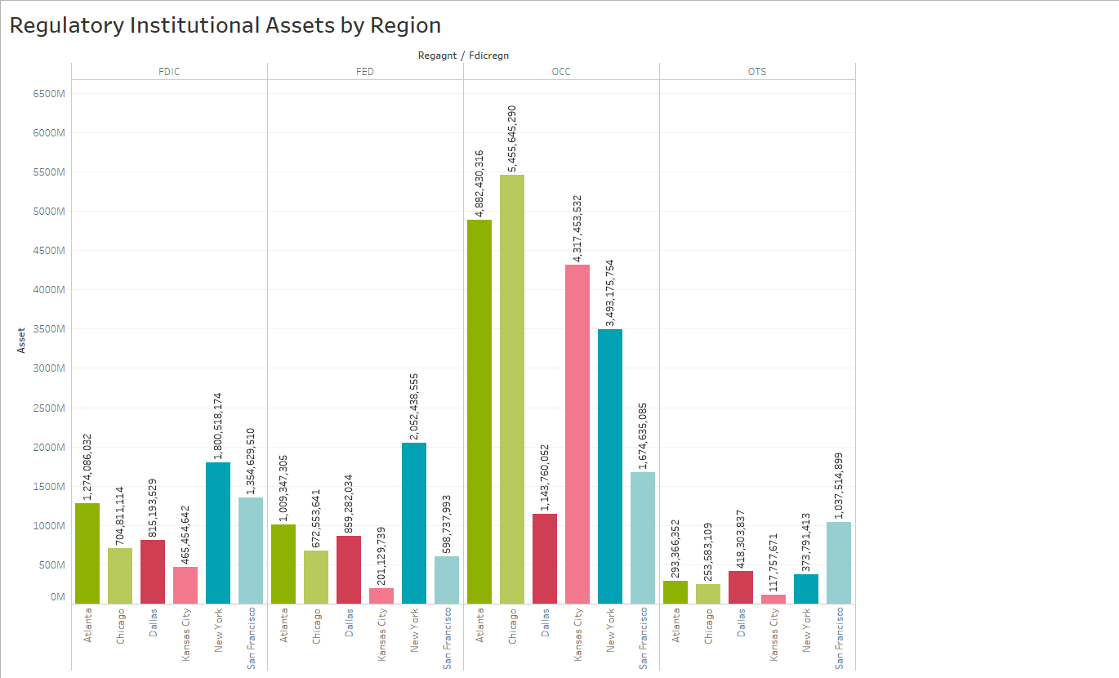
Regional Assets Governed by Regulating Agents
FDIC regulates the most institutional assets in New York .
While lowest is in Kansas City
Allocating more resources to NY, SF and Atlanta to ensure compliance could be key

Slide 31
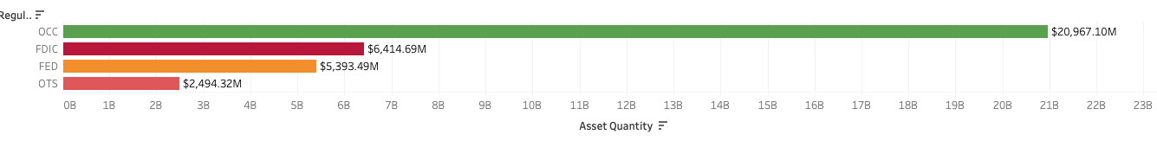
Total Assets ($$ Worth) Regulated by Agent
Ranking:
FDIC regulates the second largest financial assets after the OCC
Notes:
create view asset_quantity_view
as
select *
from (
select round(sum(asset_quantity),-6) as sum_quantity, regulator_name
from (
select reg.regulator_name,inst.asset_quantity,inst.institution_id
from fd_regulator reg inner join fd_institution inst
on reg.regulator_id=inst.regulator_id)
group by regulator_name)
select * from asset_quantity_view

Slide 32
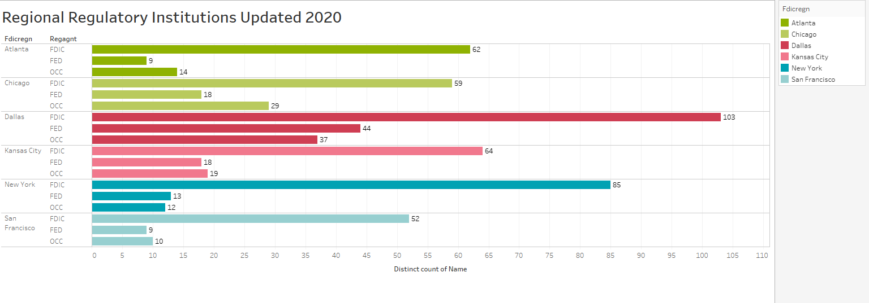
2020 Count of Regulatory Institutions Regionally
Notes:
create view regulator_efficiency_view
as
select *
from (
select distinct regulator_name, sect_sum/sect_count as regulator_efficiency
from (
select distinct regulator_name, sum(asset_quantity) over (partition by regulator_name) as sect_sum, count(regulator_name) over (partition by regulator_name) as sect_count
from(
select reg.regulator_name, inst.asset_quantity
from fd_regulator reg inner join fd_institution inst
on reg.regulator_id=inst.regulator_id)))

Slide 33
State Analysis

Slide 34
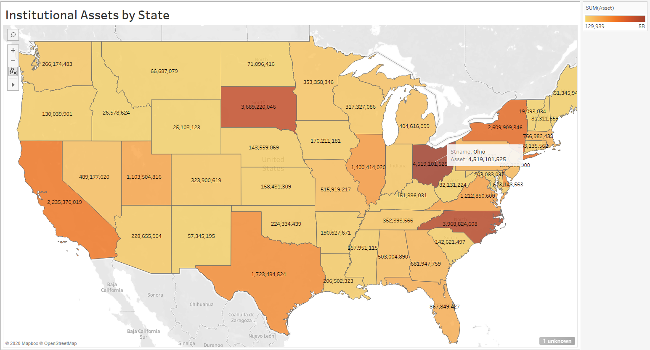
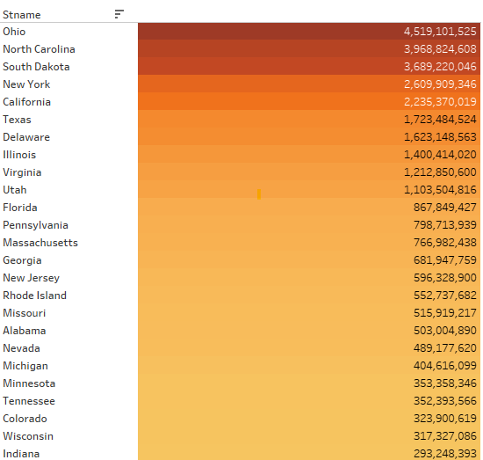
Number of Assets by State

Slide 35
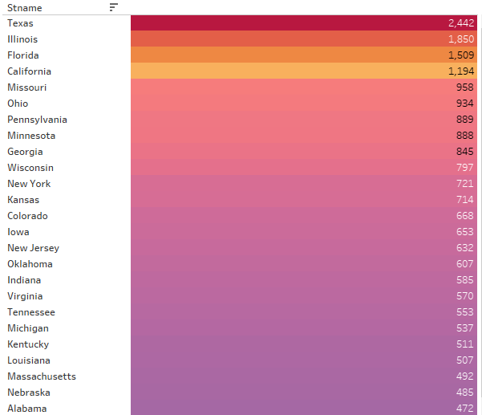
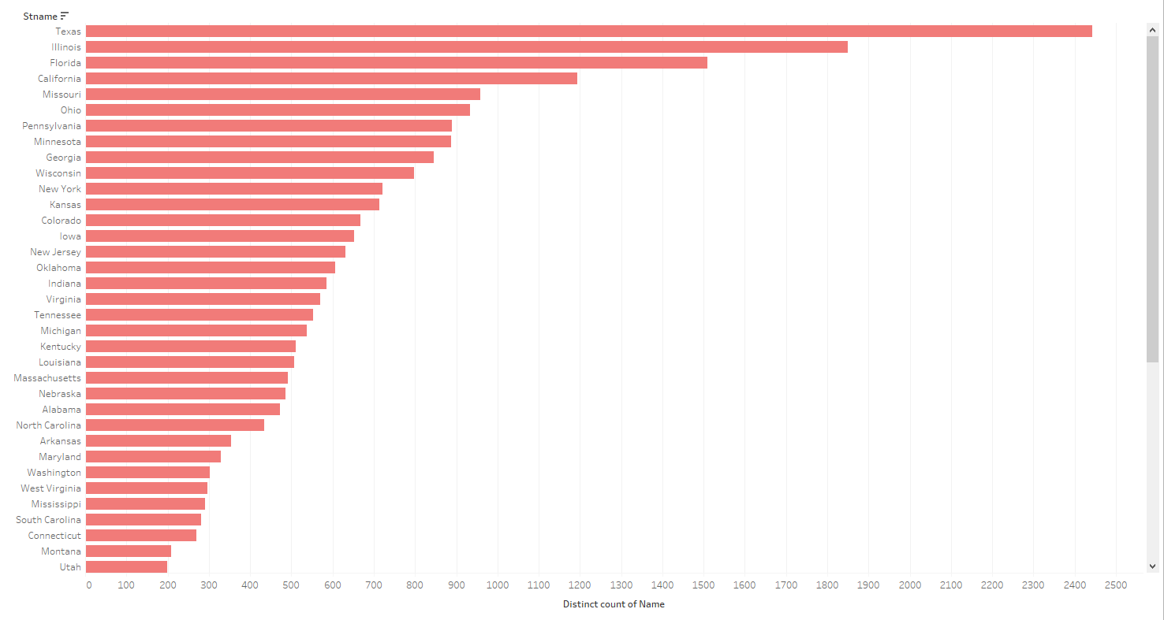
Top 25 States With Highest Insured Institutions

Slide 36
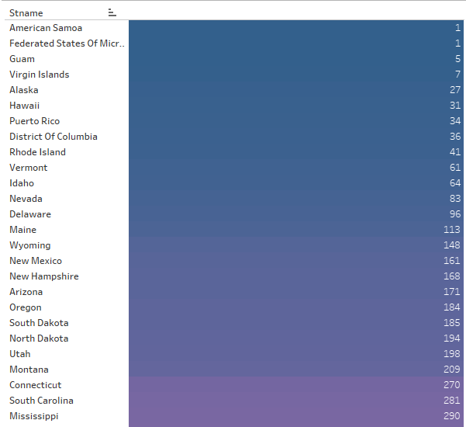
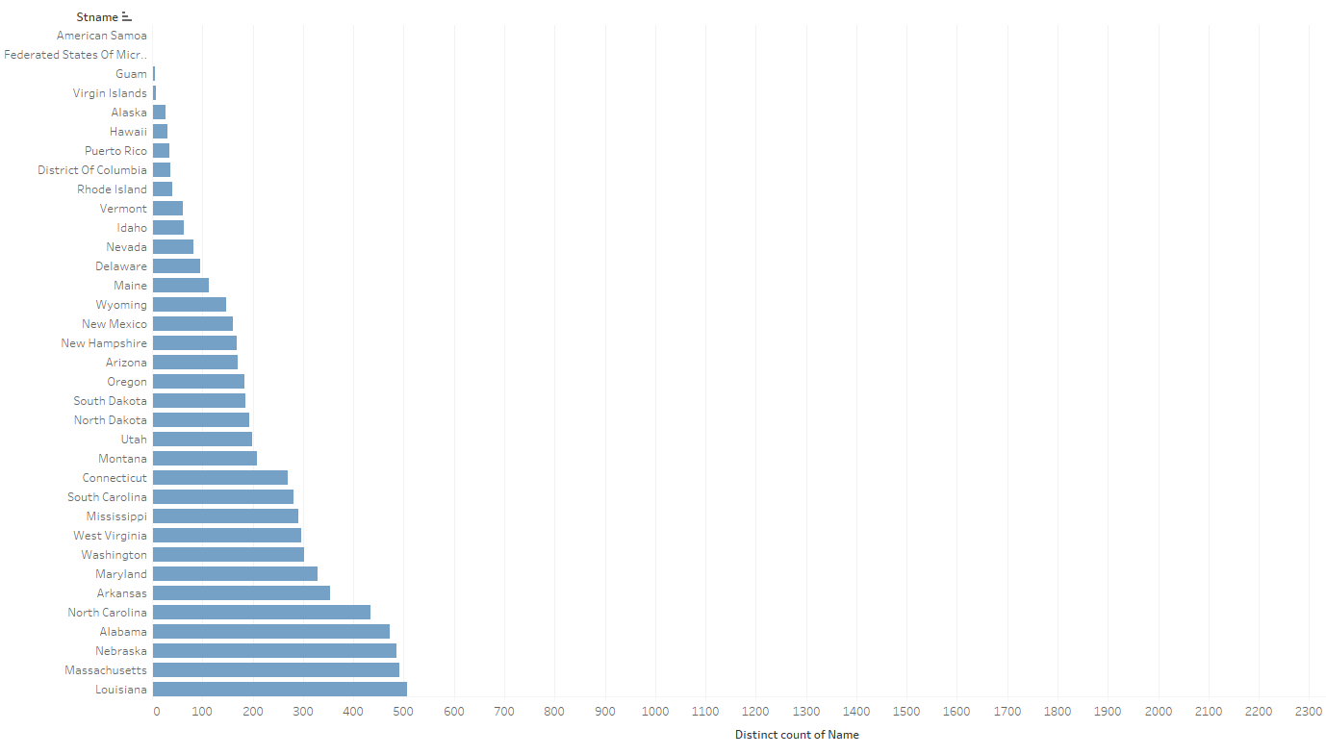
Bottom 25 States With Lowest Insured Institutions

Slide 37
Limitations and Summary

Slide 38
Limitations
Data Cleanliness and Database Integrity:
Null Data present in important columns such as Region Column
Update - Still included Regulator that no longer exists
Institutional Metrics
More data in regard to assets in dollar amount could be included.
Asset Classifications eg. securities, cash, receivables, debt...etc, if included will allow for further financial/economical analysis.

Slide 39
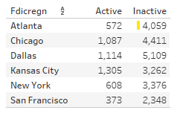
Summary
FDIC has opportunity to increase distribution of institutions on West Coast allowing more US Citizens Access to insured saving options.
For the FDIC Regionally, New York Has largest number of Assets
FDIC Governs over half of financial Institutions in the US when compared to other Regulating Agents.
FDIC has the most insured institutions in Dallas and New York regions.
Bank of America & Wells Fargo have some of the largest Assets insured by individual institutions.

